Slide 1

Bootstrap
Data Visualization and Styling
SoftUni Team
Technical Trainers
Software University
http://softuni.bg

Slide 2
Table of Contents
What is Bootstrap?
Responsive Web Design
How to import Bootstrap?
Bootstrap Grid System
Styling Components
Font Awesome

Slide 3
Have a Question?
sli.do #csharp-web

Slide 4

What is Bootstrap?
Responsive Web Design

Slide 5
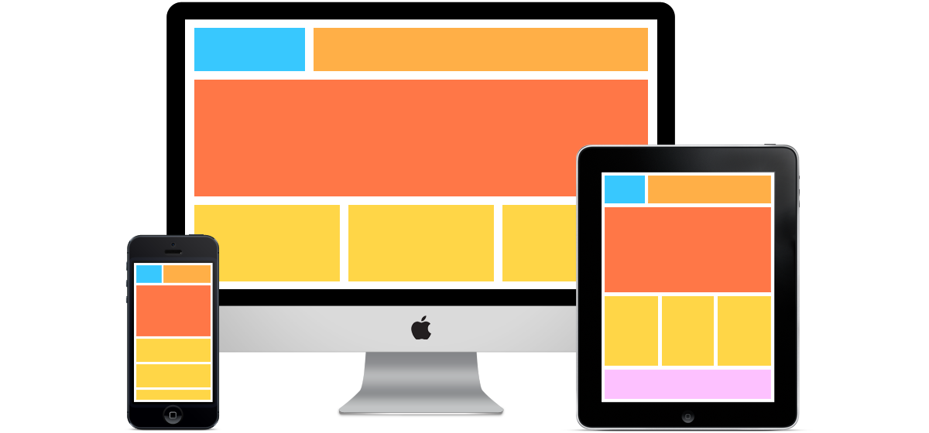
What is a Responsive Design?
Presentation layers that adjust according to the screen size of the different devices
Desktop layouts
Tablet layouts
Mobile layouts

Slide 6
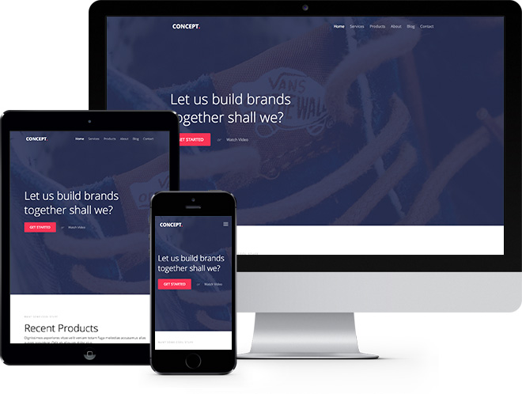
Bootstrap
Free front-end framework that provides capabilities to ensure responsive design
Great documentation
Great community
Many themes developed
Some of which – paid

Slide 7

How to Import Bootstrap?
Import Options

Slide 8
Include from a CDN – CSS File
Include the Bootstrap CSS file before any other CSS file in your project
Include the Bootstrap JS file to allow animations and other dynamic functionalities
<link rel="stylesheet" href="https://stackpath.bootstrapcdn.com/bootstrap/4.1.3/css/ bootstrap.min.css"/>
<script src="https://stackpath.bootstrapcdn.com/bootstrap/4.1.3/js/ bootstrap.min.js"/>

Slide 9


Include from a CDN – .js Files
Be sure to place jQuery and Popper before the Bootstrap JS import, as the Bootstrap code depends on them
<script src="https://code.jquery.com/jquery-3.3.1.slim.min.js"/>
<script src="https://cdnjs.cloudflare.com/ajax/libs/popper.js/ 1.14.3/umd/popper.min.js"/>

Slide 10
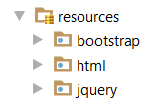
Download Resources
You can also download the resources locally
You’ll have to configure your application to return them
<link rel="stylesheet“ href="../bootstrap/css/bootstrap.min.css"/>
<script src="../jquery/jquery.3.3.1.min.js"></script>
<script src="../bootstrap/js/bootstrap.min.js"></script>

Slide 11
Grid System
Building Layouts

Slide 12
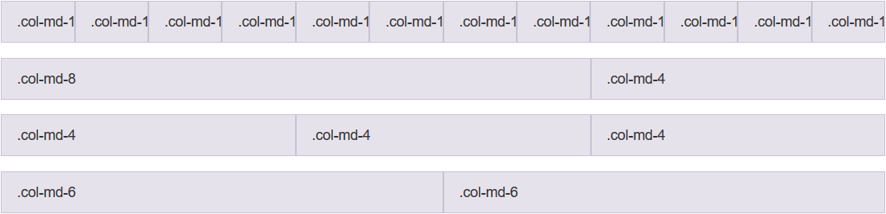
Grid System
Bootstrap includes a responsive, mobile-first, fluid grid system that appropriately scales up to 12 columns
Col 1
Col 2
Col 12
Row 1
Row 2
Row 3
Row 4

Slide 13
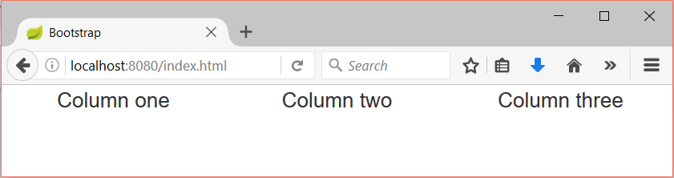
Grid System Demo
index.html
index.css
Container
…
<div class="container-fluid">
<div class="row">
<div class="col-sm-4">Column one</div>
<div class="col-sm-4">Column two</div>
<div class="col-sm-4">Column three</div>
</div>
</div>
…
div {
text-align: center;
}
Row
Columns

Slide 14
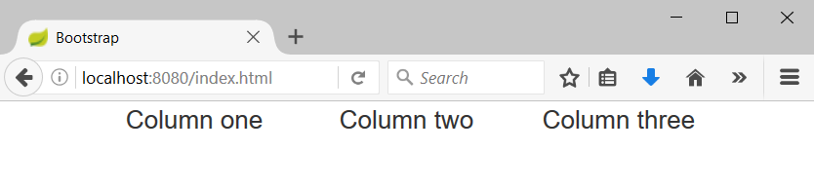
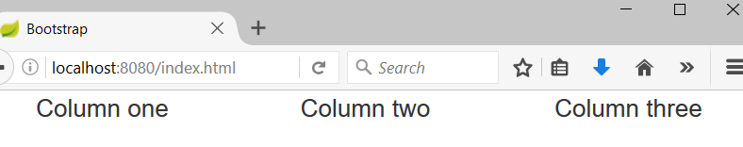
Containers
Rows must be placed in containers
.container is fixed-width
.container-fluid is full-width
Leaves margin
Full width, no margins

Slide 15
Column Classes
Determines how many columns to use on different screen sizes
.col-xs: Width Less than 768px
.col-sm: Width Between 768px and 992px
.col-md: Width Between 992px and 1200px
.col-lg: Width Over 120px
index.html
<div class="col-sm-8 col-lg-4">Column one</div>
<div class="col-sm-2 col-lg-4">Column two</div>
<div class="col-sm-2 col-lg-4">Column three</div>

Slide 16
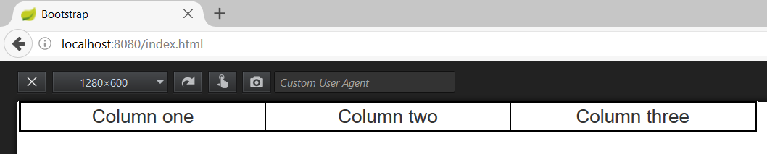
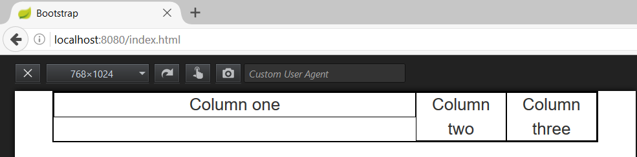
Column Classes (2)
index.html
<div class="col-sm-8 col-lg-4">Column one</div>
<div class="col-sm-2 col-lg-4">Column two</div>
<div class="col-sm-2 col-lg-4">Column three</div>
Width 1280px
Width 768px

Slide 17

Styling Components
Styling most Used Components

Slide 18
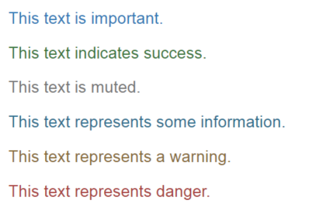
Typography with Bootstrap
Provide information about the role of the text
More on typography
More on text colors
index.html
<p class="text-primary">This text is important.</p>
<p class="text-success">This text indicates success.</p>
<p class="text-muted">This text is muted.</p>
<p class="text-info">This text represents some information.</p>
<p class="text-warning">This text represents a warning.</p>
<p class="text-danger">This text represents danger.</p>

Slide 19
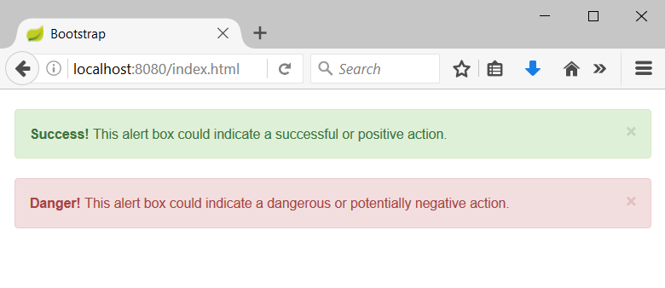
Alerts with Bootstrap
Provide information about the outcome of an event
index.html
<div class="alert alert-success alert-dismissable">
<a class="close" data-dismiss="alert" aria-label="close">×</a>
<strong>Success!</strong> This alert box could indicate a successful or positive action.
</div>
…

Slide 20
Buttons – coloring with Bootstrap
Provide information about the role of the button
index.html
<button type="button" class="btn btn-primary">Primary</button>
<button type="button" class="btn btn-secondary">Secondary</button>
<button type="button" class="btn btn-success">Success</button>
<button type="button" class="btn btn-info">Info</button>
<button type="button" class="btn btn-warning">Warning</button>
<button type="button" class="btn btn-danger">Danger</button>
<button type="button" class="btn btn-link">Link</button>

Slide 21
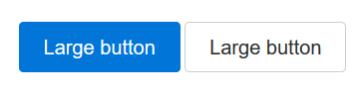
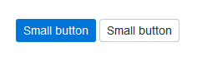
Buttons – sizing with Bootstrap
Provide information about the size of the button
More on buttons
index.html
<button type="button" class="btn btn-primary btn-lg">Large</button>
<button type="button" class="btn btn-secondary btn-lg">Large</button>
<button type="button" class="btn btn-primary btn-sm">Small</button>
<button type="button" class="btn secondary btn-sm">Large</button>

Slide 22
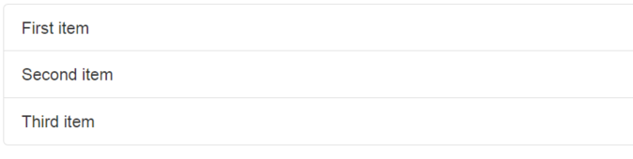
Lists with Bootstrap
Display a series of content
More on lists
index.html
<ul class="list-group">
<li class="list-group-item">First item</li>
<li class="list-group-item">Second item</li>
<li class="list-group-item">Third item</li>
</ul>

Slide 23
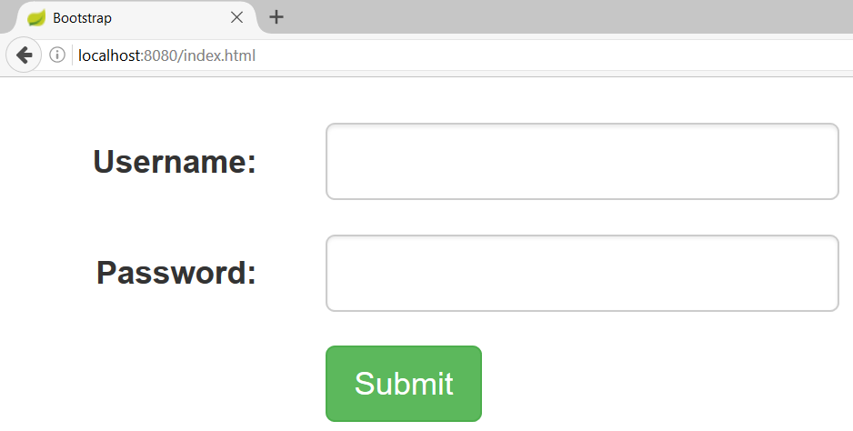
Forms with Bootstrap
index.html
<form>
<div class="form-group row">
<label class="form-control-label col-sm-2">Username:</label>
<div class="col-sm-4">
<input class="form-control" type="text"/>
</div>
</div> …
</form>

Slide 24
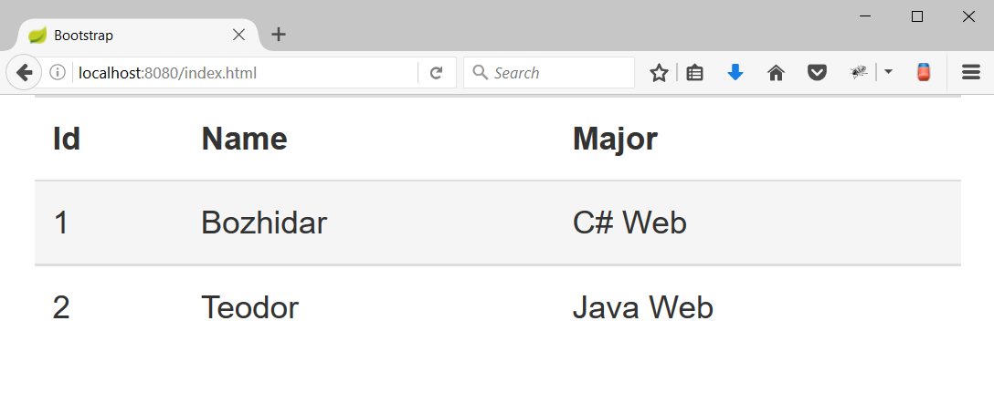
HTML Table with Bootstrap
index.html
Hover effect
<table class="table table-hover">
<tr>
<th>Id</th>
<th>Name</th>
<th>Major</th>
</tr>
<tr>
<td>1</td>
<td>Bozhidar</td>
<td>C# Web</td>
</tr>
…
</table>
Bootstrap table

Slide 25
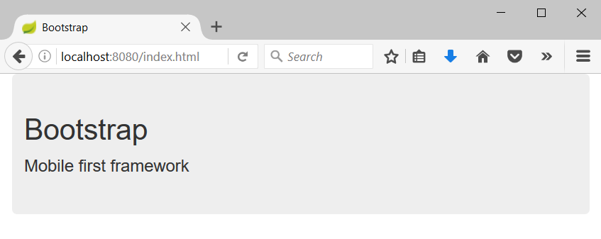
Jumbotron
Big box that provides information
index.html
<div class="container">
<div class="jumbotron">
<h1>Bootstrap</h1>
<p>Mobile first framework</p>
</div>
</div>

Slide 26

Font Awesome
Simply Awesome

Slide 27

Font Awesome
A font and icon toolkit based on CSS
The world’s most popular and easy to use icon set
Absolutely awesome
Absolutely free
Has a paid PRO License
Made for use with Bootstrap
Open Source-Friendly

Slide 28
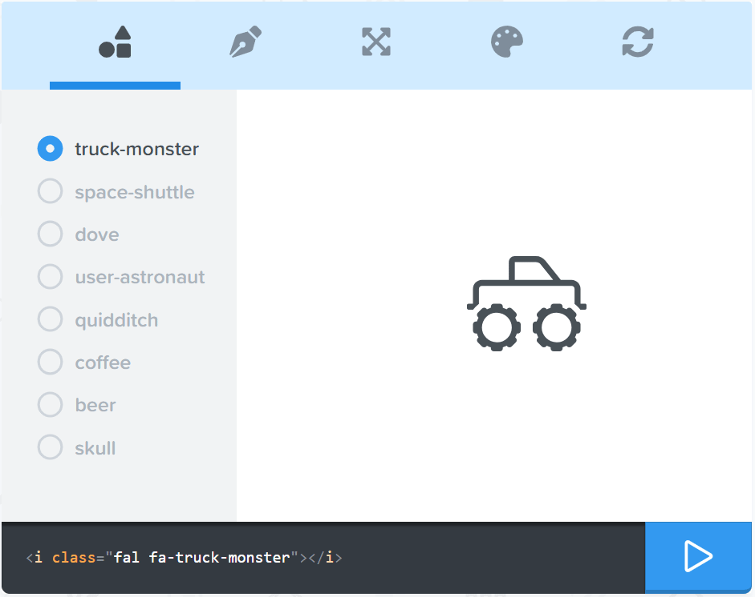
Font Awesome
Import it in your HTML via Open CDN, as a CSS style
Font Awesome [Free]
Over 1000 icons
Countless application ways
Read more about it here
<link rel="stylesheet" href="https://use.fontawesome.com/releases/v5.3.1/css/all.css">

Slide 29

Summary
Bootstrap is a front-end framework
Provides ready CSS styles
Provides ready JS functionality
Just put classes on your elements
Font Awesome
A nice set of cool icons
Most popular in the world
As its name says – It’s awesome!
…
…
…

Slide 30
https://softuni.bg/trainings/courses

Slide 31













SoftUni Diamond Partners

Slide 32





SoftUni Organizational Partners

Slide 33




Trainings @ Software University (SoftUni)
Software University – High-Quality Education and Employment Opportunities
softuni.bg
Software University Foundation
http://softuni.foundation/
Software University @ Facebook
facebook.com/SoftwareUniversity
Software University Forums
forum.softuni.bg

Slide 34

License
This course (slides, examples, demos, videos, homework, etc.) is licensed under the "Creative Commons Attribution-NonCommercial-ShareAlike 4.0 International" license

